Slide 1
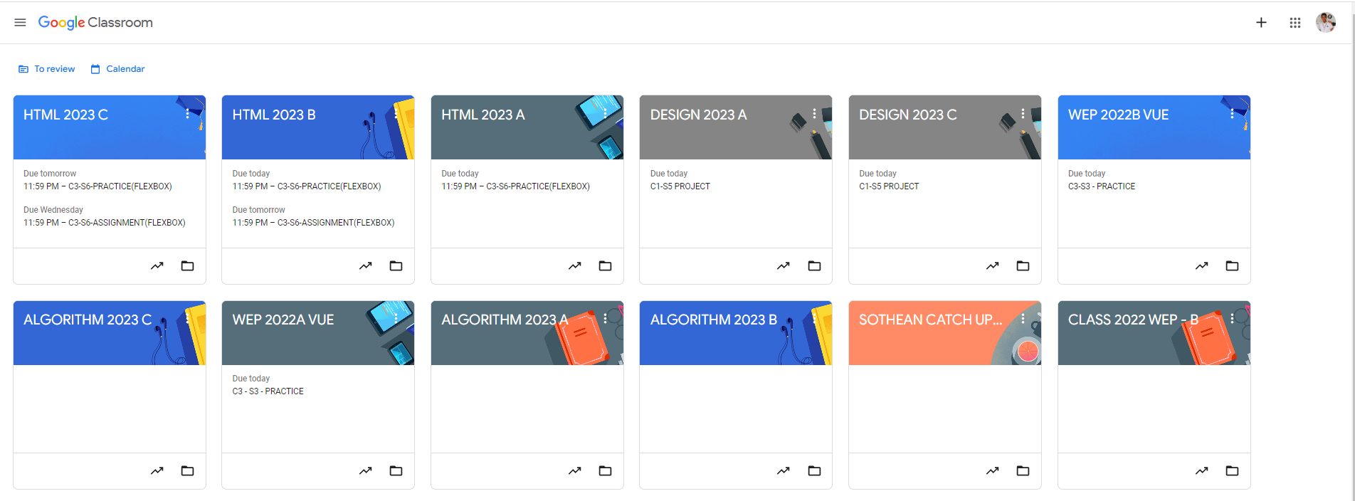
Identify root components of website below

Slide 2
Nav
Header
Main
Flex-direction: column;

Slide 3
Nav-left
Nav-right
Flex: 1;
Flex: 1;

Slide 4
icon
logo
icon
icon
icon
Nav-left
Nav-right

Slide 5
Div 1
Div 2

Slide 6
icon
text
icon
text
Div 1
Div 2

Slide 7
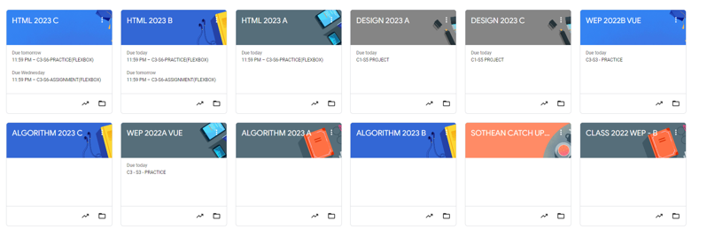

Slide 8
Flex-direction: row;
Flex-wrap: wrap;
Justify-content: flex-start;
card1
card2
card3
card4
card5
card6
card7
card8
card9
Card10
card11
card12

Slide 9
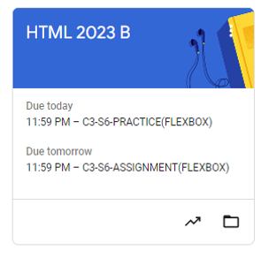
Card-header
Flex: 1.5,
Card-body
Flex: 2,
Flex: 1,
Card-footer

Slide 10
title
icon
Card-header
Card-content
Card-body
Card-content
icon
icon
Card-footer

